Slide 1
Table of Contents
This slide deck consists of slides used in 5 lecture videos in Week 2. Below is a list of shortcut hyperlinks for you to jump into specific sections.
(page 2) Week 2: JavaScript Overview and History
(page 8) Week 2: JavaScript in the Browser
(page 24) Week 2: The JavaScript Language
(page 39) Week 2: JavaScript Functions and Arrays
(page 46) Week 2: JavaScript Control Structures
Notes:
Note from Chuck. If you are using these materials, you can remove my name and URL from this replace it with your own, but please retain the CC-BY logo on the first page as well as retain the entire last page when you remix and republish these slides.
TO Highlight – go to https://tohtml.com/html/ - paste and then do a "Paste RTF"

Slide 2

JavaScript
Dr. Charles Severance
www.dj4e.com
http://www.dj4e.com/code/javascript
http://www.dj4e.com/code/javascript.zip
Notes:
https://www.destroyallsoftware.com/talks/wat

Slide 3
About JavaScript
In addition to HTML and CSS...
Browsers have a powerful programming language called JavaScript that runs in the browser
Actually not much like Java - more like Python with a C syntax
Very powerful and flexible - we keep “discovering” new power
http://en.wikipedia.org/wiki/JavaScript

Slide 4
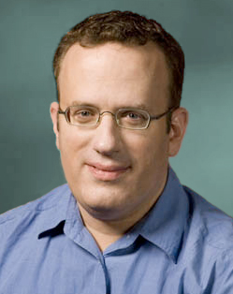
Inventing JavaScript
Introduced in Netscape in 1995
Developed by Brandon Eich
Named to make use of Java market buzz
Standardized today as ECMAScript
http://en.wikipedia.org/wiki/Brendan_Eich
https://www.youtube.com/watch?v=IPxQ9kEaF8c

Slide 5
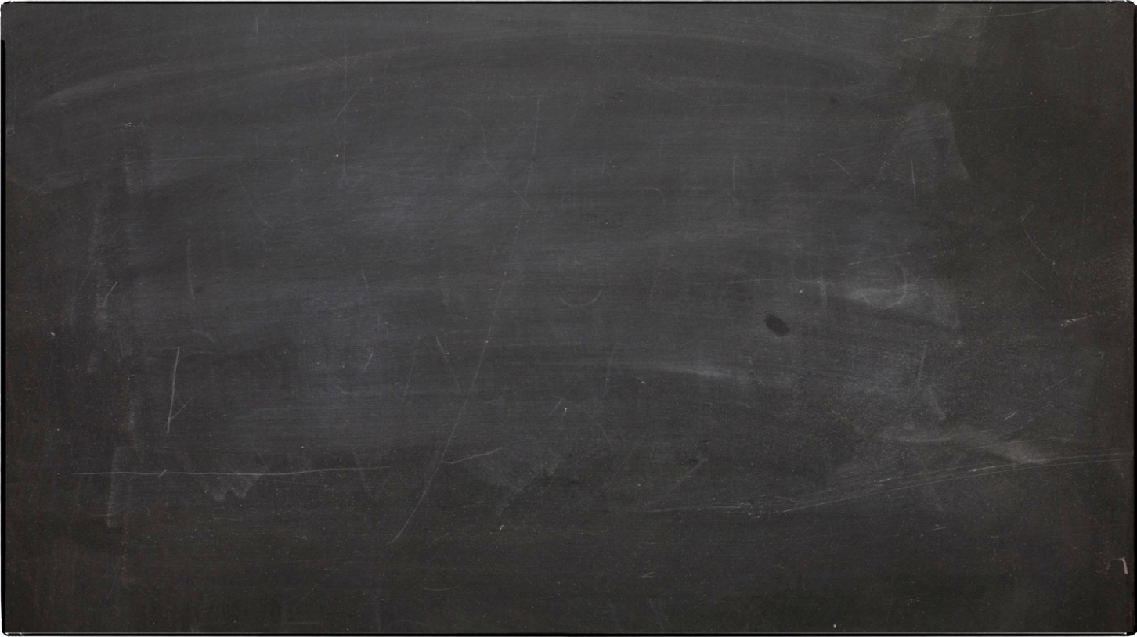
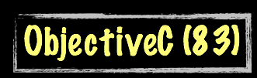
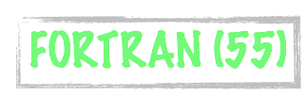


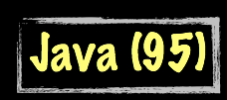




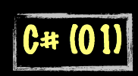

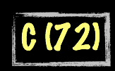
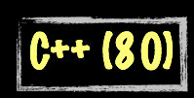

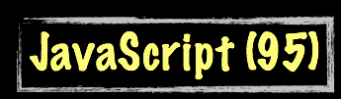



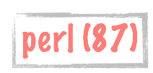
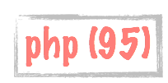

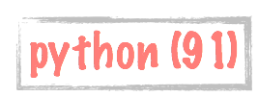
History of programming languages
Science Calculations
System
System
bash (79)
C uses curly braces { } for code blocks.
Scripting/
Interpreted
http://en.wikipedia.org/wiki/History_of_programming_languages

Slide 6
Writing JavaScript
Augment HTML using the Document Object Model (DOM) – "Vanilla JavaScript"
Augment HTML using a library like JQuery
Building an MVC Application in the Browser using Vue/React
Building a server side application using Node / Express

Slide 7
Language Syntax (like C/Java)
Whitespace does not matter - spaces and new lines
Begin and end of blocks are curly braces
Statements must end in semicolons
function message()
{
alert("This alert box was called with the onload event");
}

Slide 8
Working with JavaScript in the Browser
http://www.dj4e.com/code/javascript
http://www.dj4e.com/code/javascript.zip

Slide 9
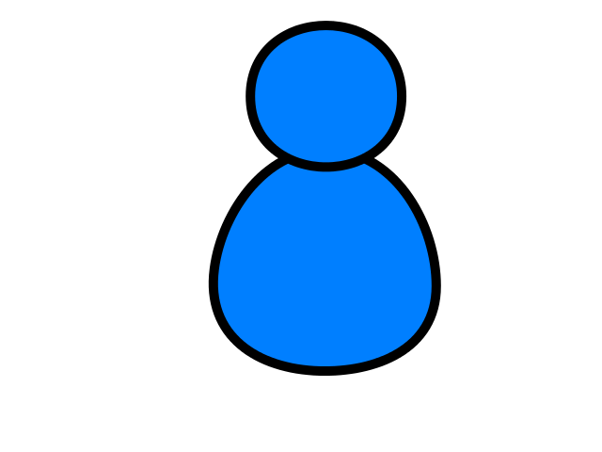
Browser
Browser
Linux
D
O
M
Django
settings.py
Routing
Click
urls.py
views.py
Parse
Response
Views
Templates
forms.py
JavaScript
Database
Shell
Models
model.py
/admin
admin.py

Slide 10
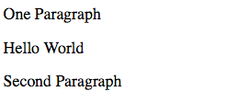
JavaScript in the Browser
<html>
<head>
<title>Hello World</title>
</head>
<body>
<p>One Paragraph</p>
<script type="text/javascript">
document.write("<p>Hello World</p>")
</script>
<noscript>
Your browser doesn't support or has disabled JavaScript.
</noscript>
<p>Second Paragraph</p>
</body>
</html>
js-01.htm

Slide 11
Low-Level Debugging
When in doubt, you can always add an alert() to your JavaScript.
The alert() function takes a string as a parameter and pauses the JavaScript execution until you press “OK”.

Slide 12
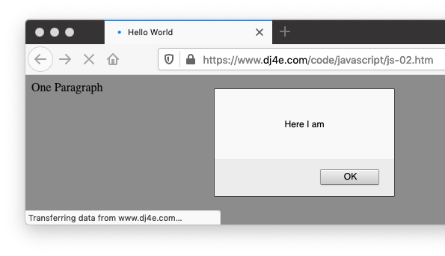
Low-Level Debugging
<html>
<head>
<title>Hello World</title>
</head>
<body>
<p>One Paragraph</p>
<script type="text/javascript">
alert("Here I am");
document.write("<p>Hello World</p>")
</script>
<noscript>
Your browser doesn't support or has disabled JavaScript.
</noscript>
<p>Second Paragraph</p>
</body>
</html>
js-02.htm

Slide 13
Including JavaScript
Three Patterns:
Inline within the document
As part of an event in an HTML tag
From a file

Slide 14
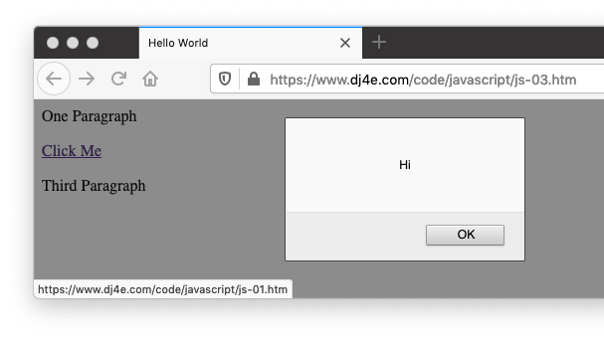
Js-03.htm
<html>
<head>
<title>Hello World</title>
</head>
<body>
<p>One Paragraph</p>
<p><a href="js-01.htm"
onclick="alert('Hi'); return false;">Click Me</a></p>
<p>Third Paragraph</p>
</body>
</html>
js-03.htm
JavaScript on a tag

Slide 15
js-04.htm
<html>
<head>
<title>Hello World</title>
</head>
<body>
<p>One Paragraph</p>
<script type="text/javascript" src="script.js">
</script>
<p>Third Paragraph</p>
</body>
</html>
JavaScript in a separate file
script.js:
document.write("<p>Hello World</p>");
js-04.htm

Slide 16
Syntax Errors
As in any language, we can make syntax errors
By default, browsers silently eat any kind of JavaScript error
But the code stops running in that file or script section

Slide 17
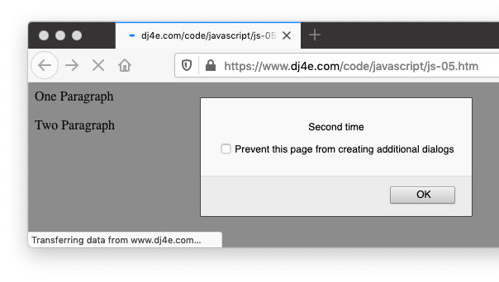
js-05.htm
<p>One Paragraph</p>
<script type="text/javascript">
alert("I am broken');
alert("I am good");
</script>
<p>Two Paragraph</p>
<script type="text/javascript">
alert("Second time");
</script>
<p>Three Paragraph</p>
js-05.htm

Slide 18
Seeing the Error
Since the end user really cannot take any action to fix the JavaScript coming as part of a web page, the browser eats the errors.
As developers, we need to look for the errors - sometimes it takes a minute to even remember to check for a JS error.

Slide 19
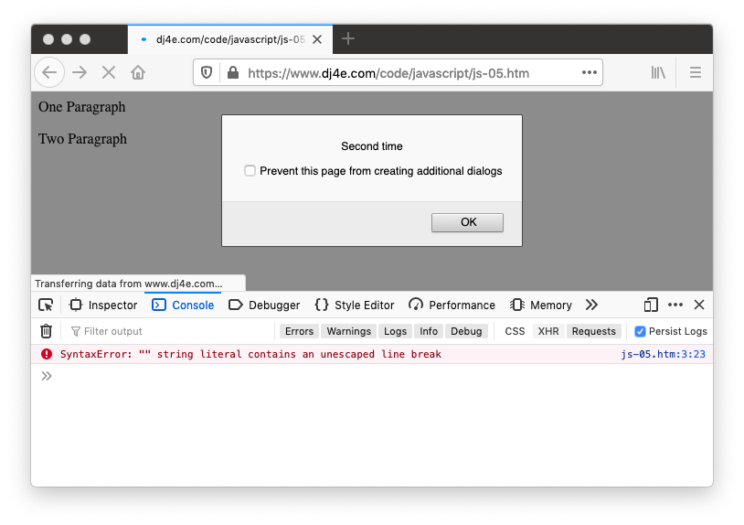
Js-05.htm
js-05.htm

Slide 20
Console Logging
Debugging using alert() can get tiring - sometimes you want to record what happens in case something goes wrong
console.log("String") - and many more functions

Slide 21
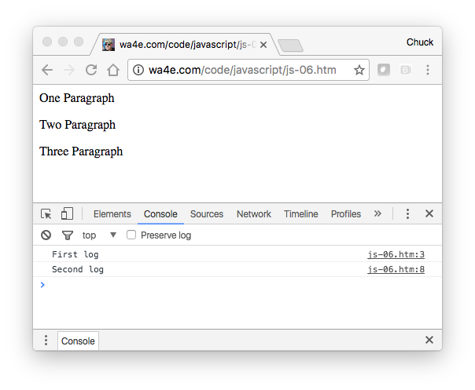
js-06.htm
js-06.htm
<p>One Paragraph</p>
<script type="text/javascript">
console.log("First log");
alert("YO");
</script>
<p>Two Paragraph</p>
<script type="text/javascript">
console.log("Second log");
</script>
<p>Three Paragraph</p>

Slide 22
Using the Debugger (Firefox)
Get into a source view.
Click on a line of JavaScript to set a breakpoint.
Reload the page.

Slide 23
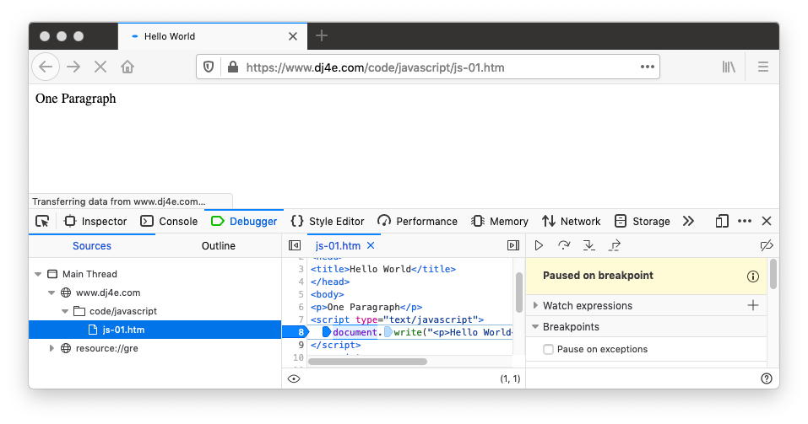
Using the Debugger

Slide 24
JavaScript Language
http://www.dj4e.com/code/javascript
http://www.dj4e.com/code/javascript.zip

Slide 25
Comments in JavaScript = Awesome
// This is a comment
/* This is a section of
multiline comments that will
not be interpreted */

Slide 26
Statements
White space and newlines do not matter.
Statements end with a semicolon ;
There are cases where you can leave the semicolon off, but don’t bother exploiting this feature - just add semicolons like in C, Java, PHP, C++, etc.

Slide 27
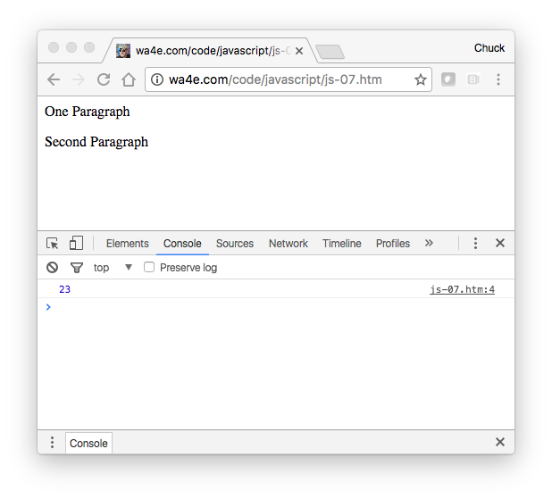
js-07.htm
<p>One Paragraph</p>
<script type="text/javascript">
x = 3 +
5 * 4; console.log(
x);
</script>
<p>Second Paragraph</p>
js-07.htm

Slide 28
Variable Names
Valid Characters: a-z, A-Z, 0-9, _ and $
Must not start with a number
Names are case sensitive
Starting with a dollar sign is considered “tacky”

Slide 29
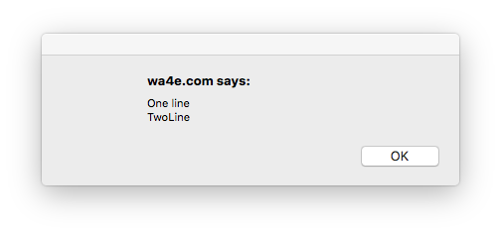
String Constants
js-08.htm
Double or Single Quotes - Single quotes are used typically in JavaScript and we let HTML use double quotes to keep our minds a little sane.
Character Escaping - done using the backslash character
<script type="text/javascript">
alert('One line\nTwoLine');
</script>

Slide 30
Numeric Constants
Constant syntax is like most other languages
Weirdness – One number type (no int or float)
>> x = 5/3;
1.6666666666666667
>> x = Math.trunc(x)
1

Slide 31
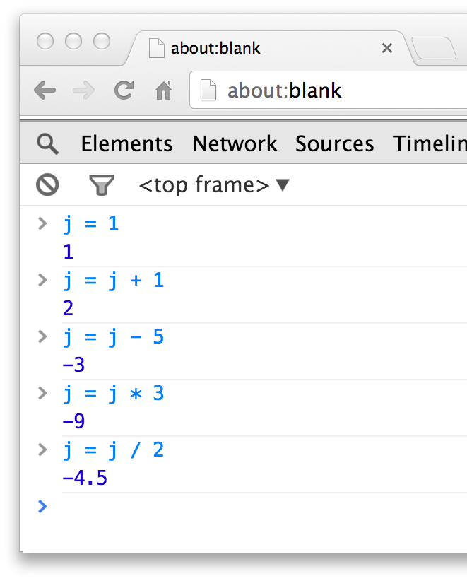
Operators
>> j = 1
1
>> j = j + 1
2
>> j = j - 5
-3
>> j = j * 5
-9
>> j = j / 5
-4.5
>> j = Math.trunc(j)
-4

Slide 32
More Operators
>> j = 45
45
>> k = j % 7
3
>> k++
3
>> k
4
>> --k
3
>> k
3
>> j = 10
10
>> j += 5
15
>> j -= 3
12
>> j *= 2
24
>> j /= 4
6

Slide 33
Comparison Operators
>> j = 10
10
>> j == 10
true
>> j != 17
true
>> j < 43
true
>> j > 42
false
>> j <= 10
true
>> j = false
false
>> j == 0
true
>> j === 0
false
>> j !== false
true
>> j !== true
true

Slide 34
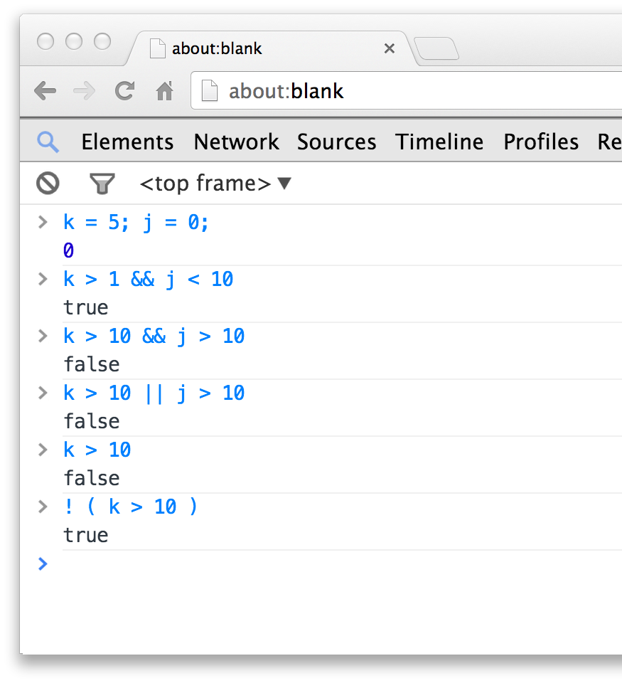
Logical Operators
>> k = 5; j = 0
0
>> k > 1 && j < 10
true
>> k > 10 && j > 10
false
>> k > 10 || j > 10
false
>> k > 10
false
>> ! ( k > 10 )
true

Slide 35
String Concatenation
JavaScript string concatenation is like Python except that it does implicit conversion from integer to string
>> x = 12
12
>> y = 'Hello ' + x + ' people'
"Hello 12 people"

Slide 36
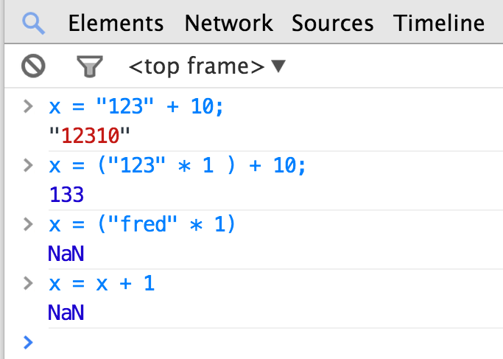
Variable Typing
JavaScript is a loosely typed language and does automatic type conversion when evaluating expressions. It does not trace back when arithmetic is confusing.
>> x = "123" + 10
"12310"
>> x = ("123" * 1) + 10
133
>> x = ("fred" * 1) + 10
NaN
>> x = x + 1
NaN

Slide 37
Variable Conversion
>> x = "fred" + 1
NaN
>> isNaN(x)
true
>> x = x + 1
NaN
>> y = 42 / 0
Infinity
>> isNaN(y)
false
>> isInfinty(y)
false
If a string cannot be converted to a number, you end up with “Not a Number” or “NaN”. It is a value, but it is sticky - all operations with NaN as a operand end up with NaN.

Slide 38
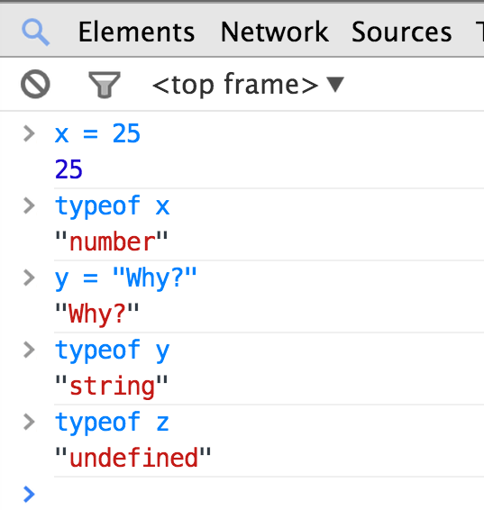
Determining Type
JavaScript provides a unary typeof operator that returns the type of a variable or constant as a string.
>> x = 25
>> typeof x
"number"
>> y = "Why?"
"Why?"
>> typeof y
"string"
>> typeof z
"undefined"

Slide 39
Functions and Arrays

Slide 40
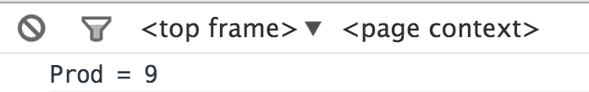
Functions
js-09.htm
Functions use a typical syntax and are indicated using the function keyword.
The return keyword functions as expected.
<script type="text/javascript">
function product(a,b) {
value = a + b;
return value;
}
console.log("Prod = "+product(4,5));
</script>

Slide 41
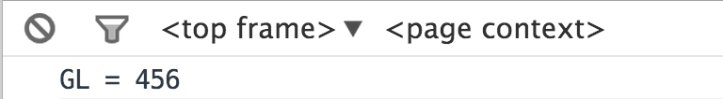
Scope - Global (default)
js-10.htm
Variables defined outside a function that are referenced inside of a function have global scope.
This is a little different than what we expect.
<script type="text/javascript">
gl = 123;
function check() {
gl = 456;
}
check();
console.log("GL = "+gl);
</script>

Slide 42
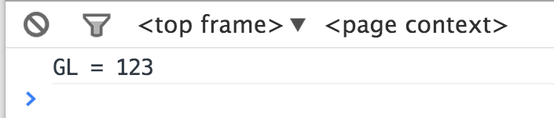
Making a Variable Local
js-11.htm
In a function, the parameters (formal arguments) are local and any variables we mark with the var keyword are local too.
<script type="text/javascript">
gl = 123;
function check() {
var gl = 456;
}
check();
console.log("GL = "+gl);
</script>

Slide 43
Arrays in JavaScript
JavaScript supports both linear arrays and associative structures, but the associative structures are actually objects.
>> a = ["x", "y", "z"]
["x", "y", "z"]
>> b = {"name":"chuck", "class":"dj4e"}
Object {"name":"chuck", "class":"dj4e"}
>> a[0]
"x"
>> b['name']
"chuck"

Slide 44
Linear Arrays
>> arr = Array()
[]
>> arr.push('first')
1
>> arr.push('second')
2
>> arr
["first", "second"]
>> arr = Array()
[]
>> arr[0] = 'first'
"first"
>> arr[1] = 'second'
"second"
>> arr
["first", "second"]

Slide 45
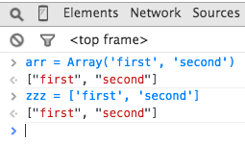
Array Constructor / Constants
>> arr = Array('first', 'second')
["first", "second"]
>> zzz = ["first", "second"]
["first", "second"]
>>

Slide 46
Control Structures

Slide 47
Conditional - if
js-12.htm
Logical operators ( == != < > <= >= && || ! === !==)
Curly braces
<script type="text/javascript">
var ans = 42;
if (ans == 42 ) {
console.log("Hello world!");
} else {
console.log("Wrong answer");
}
</script>
Hello World!

Slide 48
Multi-way Ifs
js-13.htm
var x = 7;
if ( x < 2 ) {
console.log("Small");
} else if ( x < 10 ) {
console.log("Medium");
} else {
console.log("LARGE");
}
console.log("All done");

Slide 49
js-14.htm
js-14.htm
var fuel = 10;
while (fuel > 1) {
console.log("Vroom");
}
A while loop is a “zero-trip” loop with the test at the top before the first iteration starts. We hand construct the iteration variable to implement a counted loop.
var fuel = 10;
while (fuel > 1) {
console.log("Vroom");
fuel = fuel - 1;
}

Slide 50
Definite Loops (for)
js-15.htm
balls = {"golf": "Golf balls",
"tennis": "Tennis balls",
"ping": "Ping Pong balls"};
for (ball in balls) {
console.log(ball+' = '+balls[ball]);
}
js-12.htm

Slide 51
js-16.htm
js-16.htm
Loop runs while TRUE (top-test)
Run after each iteration.
Before loop starts
for(var count=1; count<=6; count++ ) {
console.log(count, 'times 6 is', count * 6);
}
1 times 6 is 6
2 times 6 is 12
3 times 6 is 18
4 times 6 is 24
5 times 6 is 30
6 times 6 is 36
A for loop is the simplest way to construct a counted loop.

Slide 52
Breaking Out of a Loop
js-17.htm
The break statement ends the current loop and jumps to the statement immediately following the loop.
for(var count=1; count<=600; count++ ) {
if ( count == 5 ) break;
console.log('Count:', count);
}
console.log("Done");
Count: 1
Count: 2
Count: 3
Count: 4
Done

Slide 53
Finishing an Iteration with continue
The continue statement ends the current iteration and jumps to the top of the loop, and starts the next iteration.
Count: 1
Count: 3
Count: 5
Count: 7
Count: 9
Done
for(var count=1; count<=10; count++ ) {
if ( (count % 2) == 0 ) continue;
console.log('Count:', count);
}
console.log("Done");
js-18.htm

Slide 54
Try / Catch / Finally
try {
x = y + 1;
console.log(x);
}
catch(erval) {
console.log('Oops - Sorry');
console.dir(erval);
}
finally {
console.log('Always runs');
}
js-19.htm

Slide 55
Summary
Using JavaScript
Syntax errors
Debugging
Language features
Global and local scope
Arrays
Control structures

Slide 56
Acknowledgements / Contributions
These slides are Copyright 2010- Charles R. Severance (www.dr-chuck.com) as part of www.dj4e.com and made available under a Creative Commons Attribution 4.0 License. Please maintain this last slide in all copies of the document to comply with the attribution requirements of the license. If you make a change, feel free to add your name and organization to the list of contributors on this page as you republish the materials.
Initial Development: Charles Severance, University of Michigan School of Information
Insert new Contributors and Translators here including names and dates
Continue new Contributors and Translators here
Notes:
Note from Chuck. Please retain and maintain this page as you remix and republish these materials. Please add any of your own improvements or contributions.

